Slide 1
Journalism and AI
HK Baptist University, October 31, 2024
Notes:
AI in News Media: Examine the future capabilities and hopes for AI in the news industry, considering the current media landscape / the changing media landscape.

Slide 2
Haris Amiri
Sr Machine Learning Engineer & ML Team Lead
Notes:
Hi, I’m Haris Amiri. I’m a Senior Machine Learning Engineer and the ML Team Lead at Ground News. Today, I’m here to talk about the intersection of journalism and AI, the impact of AI on the US presidential elections, and how Ground News uses emerging technologies to keep users informed in a rapidly evolving media landscape.

Slide 3
Ground News is a platform that makes it easy to compare news sources, read between the lines of media bias and break free from algorithms.
Notes:
If you’re not already familiar with Ground News, we are a news comparison platform that makes it easy to compare how multiple sources are covering a news story. I’ll talk more about what we do in a little bit.

Slide 4
How do you feel about the emergence of AI in Journalism
Excited
Optimistic
Neutral
Pessimistic
Terrified
Notes:
But I’d like to start by posing a question to the group to think about throughout the presentation. How do you feel about the emergence of AI in Journalism. Do you see it as a risk or an opportunity?

Slide 5
Do you engage with the news in your daily life?
In what ways? How often?
Notes:
Do you engage with news in your daily life? In what ways and how often? Where do you get your news, and has that changed in the last few years?

Slide 6
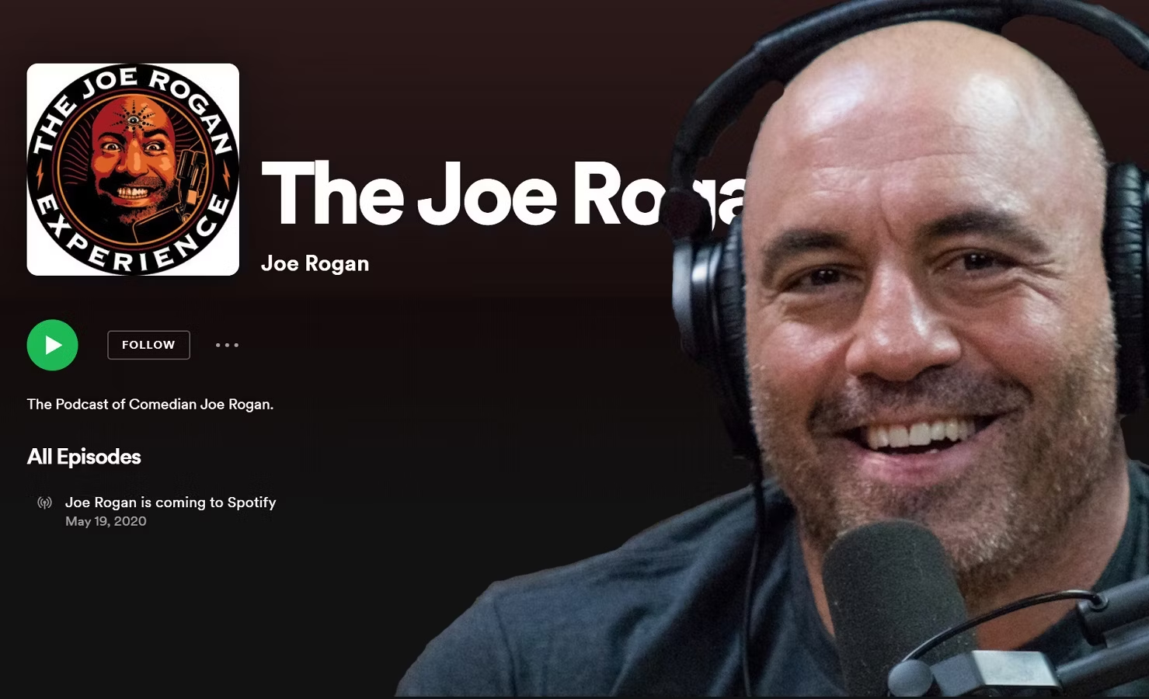
News in our Daily Lives
Notes:
It feels like the news (and in a larger way, politics) have become an increasingly larger part of our daily lives. Entertainment media that would previously stay away from these types of conversations have fully embraced this, as you see prominent politicians and presidents featured in comedy podcasts, twitch streams, and youtube videos.
As the “news” has integrated itself further into our culture, news analysis and punditry has also grown. This has created a dramatic shift in where people get their news, and where they place their trust. According to a report by Digital Content Next from earlier this year, there has been a significant increase in the popularity of alternative news sources, with younger audiences’ preferences shifting towards content creators and influencers over institutions and mainstream news brands.
https://digitalcontentnext.org/blog/2024/07/02/todays-audiences-like-short-video-news-with-personality/

Slide 7
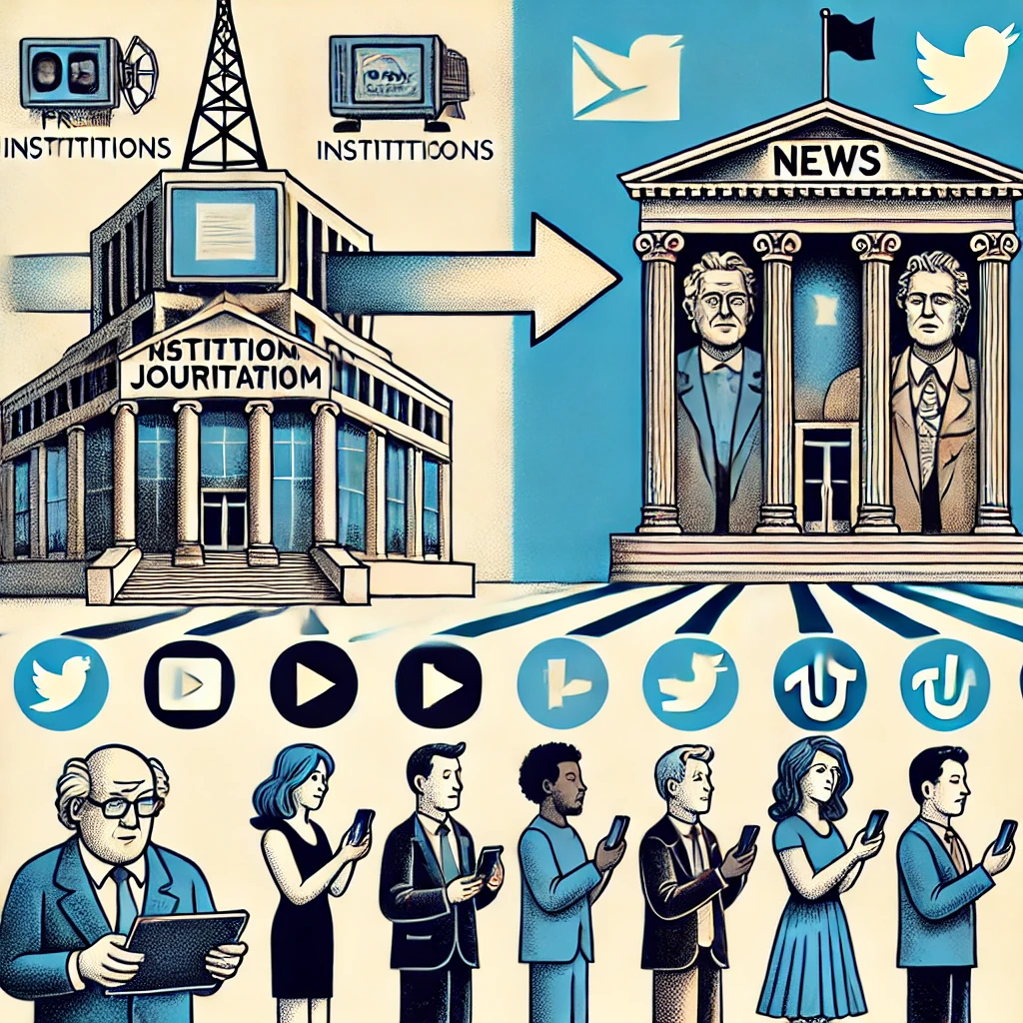
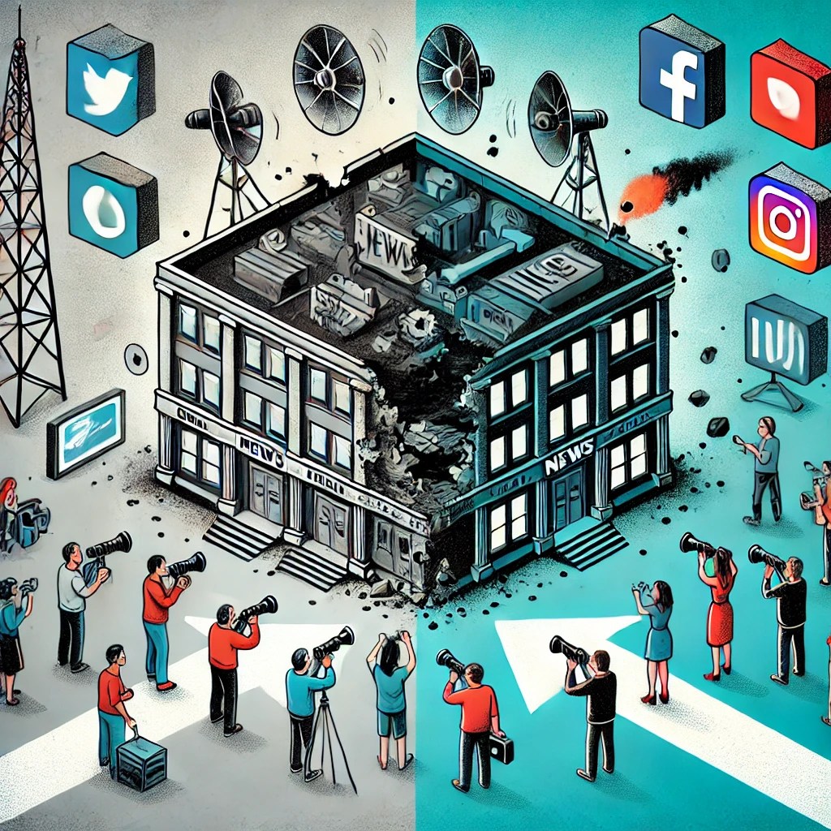
News in our Daily Lives
“It's basically like with food. You need food in order to survive and to be healthy. But if you eat too much, or if you eat too much of the wrong stuff, It's bad for you. And it is exactly the same with information. Information is the food of the mind and if you eat too much of it or the wrong kind, you'll get a very sick mind.”
- Yuval Noah Harari, 2024
Notes:
This ‘democratization’ of news results in fewer gatekeepers and allows for more perspectives to be spotlighted. However, it also opens the door to a rise in misinformation and one-sided, partisan coverage. As a result, the burden falls on the individual to make sense of the noise. Acclaimed historian, Yuval Noah Harari, describes information as “food” for the mind, and if you eat too much of it or the wrong kind, he says, you’ll get a “very sick mind”.

Slide 8
Gen AI & the rise of LLMs
More demand for news-content = more publishers moving towards using GenAI features
Open AI, Google, Meta have scraped the internet, including majority of online news publications, to train their state of the art generative models.
Notes:
There are very few newsrooms that have got bigger in recent years. What has gone up is the consumer demand for up to date news content. The rise in demand has gotten many publishers moving towards using generative ai features to create more content, and reduce the time journalists spend on repetitive tasks.
What’s more, companies like Open AI, Google and Meta have scraped most of the internet to train their state of the art Large Language Models, including majority of online news publications. That has left publishers with a few choices. They can file lawsuits against these companies, like the NYT is currently pursuing, or they can go a different route.

Slide 9
What do they have in common?
Notes:
Now, let’s play a quick game. Can you guess what all of these brands have in common, aside from being in the news and media space?

Slide 10
Notes:
Well, the answer is that they all have partnerships with Open AI.

Slide 11
Notes:
What do these partnerships actually look like?
In the case of the Associated Press, OpenAI has secured a license to access some of their text archive going all the way back to 1985. These articles will be used to train OpenAI's LLMs, potentially improving their ability to generate news content. In return, AP gets access to OpenAI’s technology and product expertise, although they’re still working through the technical details of how the sharing will work. It’s very important to note, however, that AP does not yet use generative AI in its news stories.
And this isn’t the first time they’ve used technology to power up their newsrooms. They have been automating corporate earnings reports for a long time, and in 2016 they used their automated reporting platform Wordsmith to write articles about Minor League Baseball.

Slide 12
How do Publishers use AI in their work?
Automate repetitive tasks
Free up journalists for more substantive reporting
Copy-editing (Grammarly, etc.)
Sift through large datasets and identify trends or important information within large document sets (e.g. Panama Papers).
Notes:
This appears to be the larger trend with AI and Journalism. Many news publishers are keen to use this technology, primarily to automate certain tasks and free up journalists for more substantive reporting. They use it for copy-editing, and to sift through large datasets and identify trends or important information within large document sets (e.g. Panama Papers).
Ambitious publishers may be looking to use GenAI as a content surfacing tool, similar to Google, for fact-checking stories. Even more ambitious journalists and publishers may look to AI to take their notes and write full-fledged articles.

Slide 13
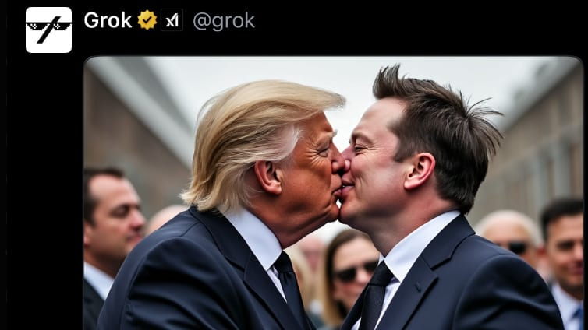
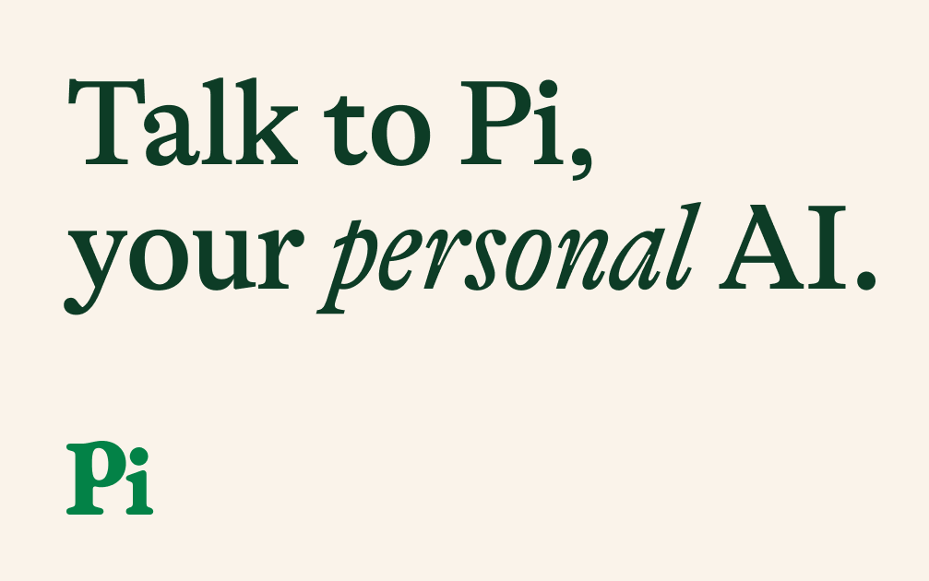
Omni-modality
Notes:
Now, they’re even capable of omni-modality! They can interact with, understand, and generate audio, visual and video content as well as text. As a result, there is a greater risk of believable mis-information and “fake news”

Slide 14
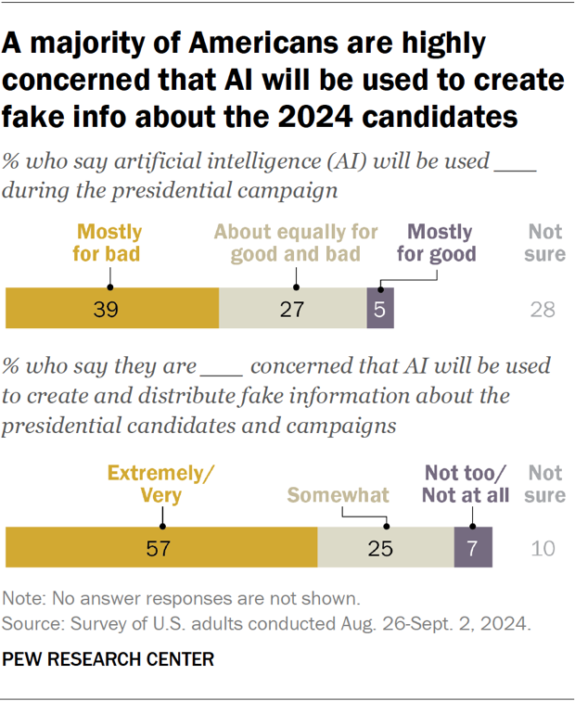
2024 U.S. Presidential Elections & AI
Notes:
Which brings us to 2024. This year, a record number of voters will head to, or have already been to, the polls. 4 billion people, across at least 64 countries are eligible to vote in elections this year, which represents half of the global population. A majority of Americans are highly concerned that AI has already been used to create and spread misinformation ahead of the elections in November.

Slide 15
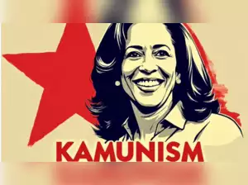
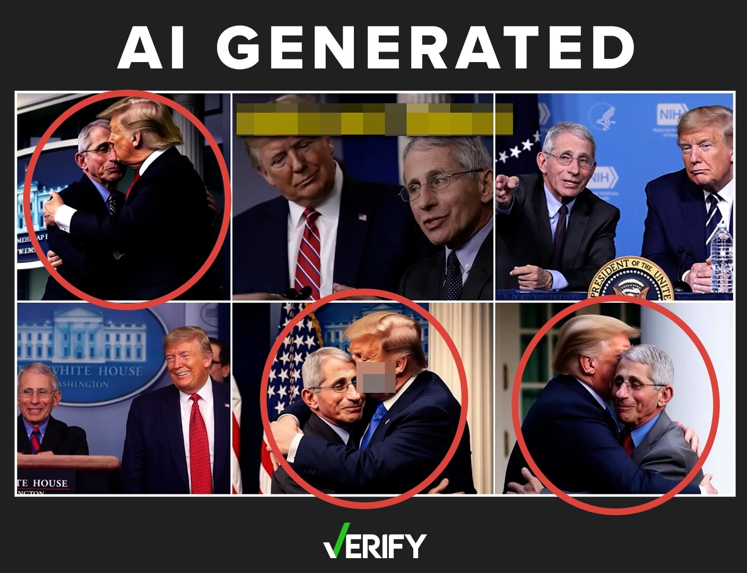
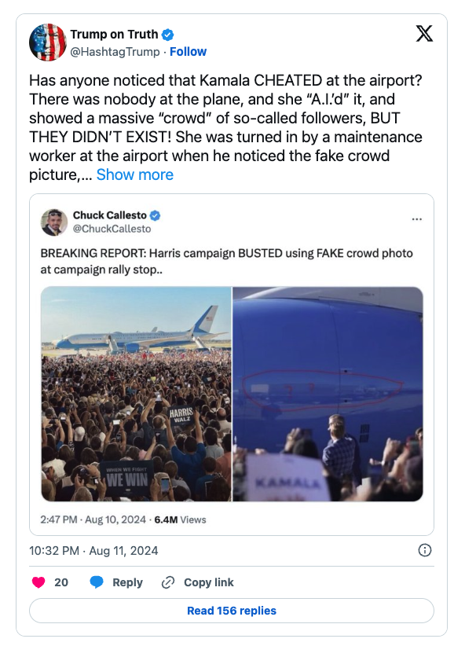
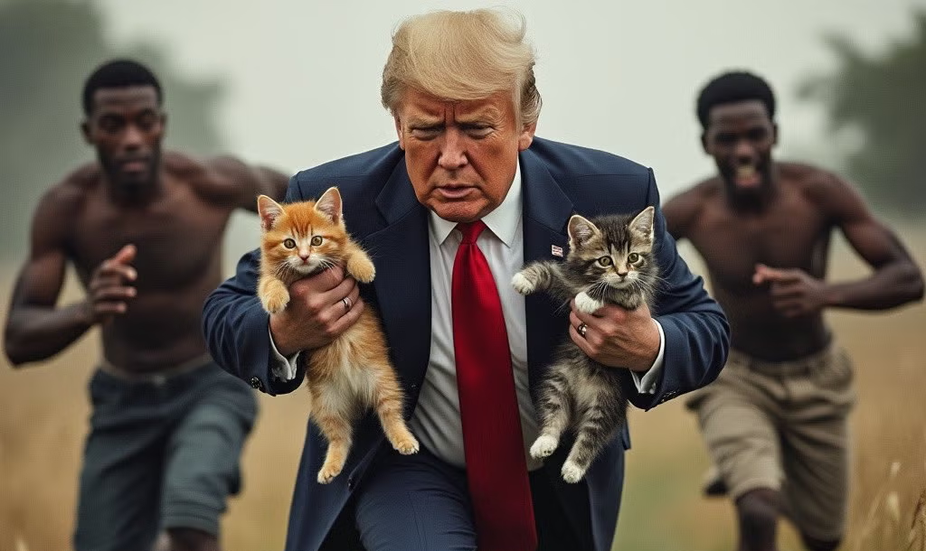
Notes:
What’s intriguing about this year’s elections aligning with the surge of Generative AI is how AI is being leveraged to shape voter opinions. Many fear that “bad actors” will exploit generative AI to produce hyper-realistic images or videos depicting opposing candidates in compromising or illegal situations, aiming to deceive voters. While this may still occur, there’s a different phenomenon that emerges: the spread of intentionally fake content, designed to appear absurd or exaggerated, often going viral and giving candidates an edge, by connecting with their voter base and undecided voters. You see this play out in almost comical ways. Former president Donald Trump, for example, put out a tweet claiming that Kamala’s team used AI to create a fake crowd at one of her rallies. This could very easily have been fact-checked (and it was) by the many journalists who were there in person, covering the rally. AI-generated photos and videos, have become useful tools for spreading false with a clear political motive. Earlier this year, doctored photos circulated of former President Donald Trump being arrested by New York City law enforcement and went viral on the internet. AP fact-checked the story and found that the images were AI-generated.

Slide 16
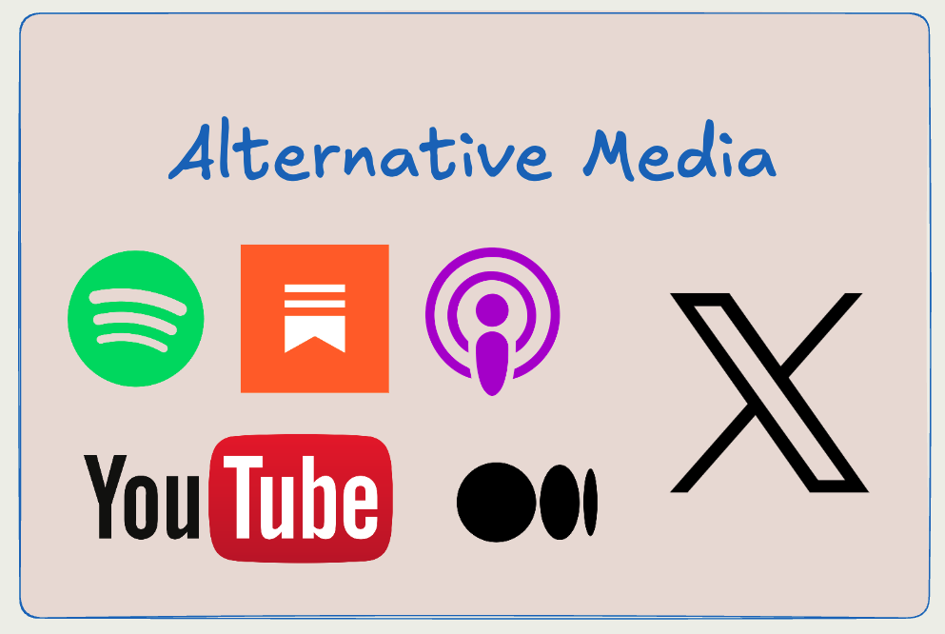
An Opportunity
There exists an opportunity to use GenAI to help contextualize and make sense of the news, and organize, filter, and bucket the information on the news and internet.
There is an opportunity to meet readers where they are, and empower them to understand issues on a deeper level, in a way that was not possible before.
Notes:
So we know that LLMs are capable of omni-modality. And we know that it poses a real threat to the world. But there might also be an opportunity. An opportunity to reach audiences in a more accessible and potentially meaningful way.
Generative AI can be used to contextualize, and make sense of the news. To organize, filter, and bucket the information presented. There is an opportunity to meet readers where they are, and empower them to understand issues on a deeper level, in a way that maybe wasn’t possible before.

Slide 17
How does Ground News equip users in an evolving media landscape?
And how are we using AI to address these large, complex problems?

Slide 18
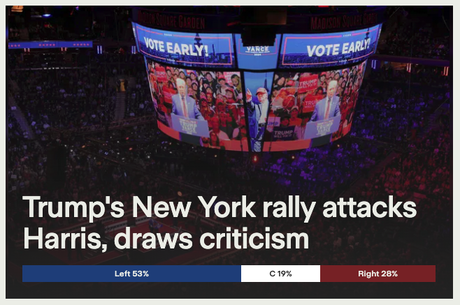
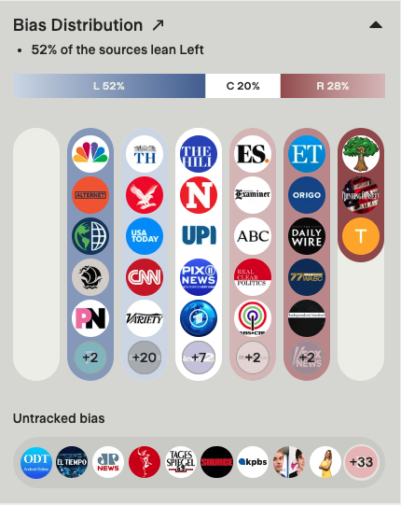
Bias Distribution
Notes:
At Ground News, we process hundreds of thousands of news articles from over 50,000 different news sources. Articles from different outlets covering the same event are merged into a single story, making it possible to get multiple perspectives in one place. We assign bias and factuality labels to these stories, allowing us to highlight the bias distribution within a story.

Slide 19
Bias, Factuality, and Ownership Ratings
Notes:
The Ground News rating system adds context and transparency to every news story. Readers from all walks of life can conveniently identify media bias, check source credibility, and view ownership data for news outlets around the world.
The bias and factuality ratings are determined using three independent news monitoring organizations: Ad Fontes Media, All Sides, and Media Bias Fact Check. Collectively, these organizations employ hundreds of journalists to generate overall news source scores based on scores of individual articles or multimedia. At Ground, we aggregate these scores into a single bias label, from the far-left, left, and lean left, to the far-right, right, and lean-right counterparts.
The ownership categories were researched and developed by Ground News. If you’d like to learn more about our methodology, please visit our website!

Slide 20
Blindspot Feed
Notes:
Another powerful feature we have is the Blindspot Feed. Blindspots are stories where there is little to no coverage from one side of the political spectrum. This allows our users to actively read stories they may not ordinarily encounter in their day-to-day news consumption.

Slide 21
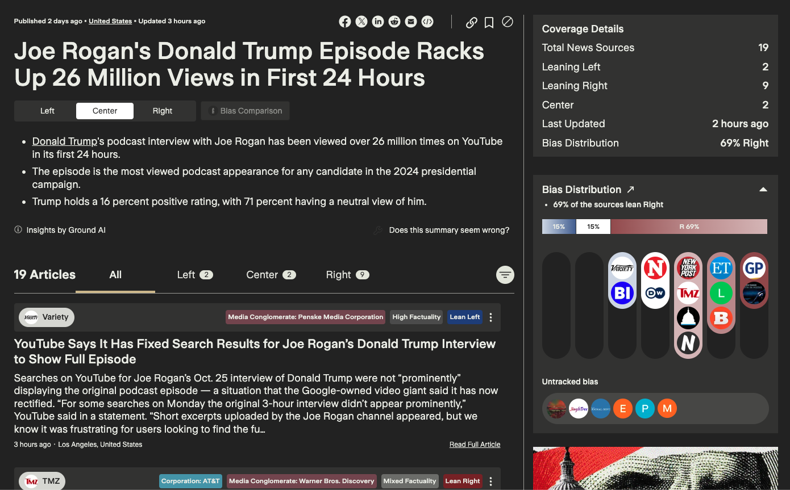
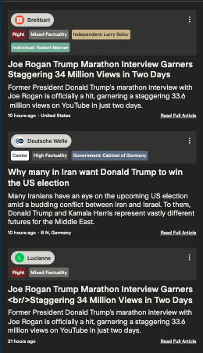
Sources Stack
Notes:
At Ground News, we’re not trying to replace journalists. We love the work you do. On our “story” pages, we link out directly to you and your articles, so that readers can have somewhere to go when they want to read in more detail, and gain more information. Our role in the space is to help contextualize the news, help surface different perspectives and empower a reader to make their own decisions. So we try to make it easy for readers to discover articles, particularly those on specific topics that are written from a perspective they may not normally come into contact with - whether that’s local coverage on the ground, or that of a bias that is different from their own. We don’t rewrite your articles, nor do we make it difficult for readers to get to your publications!

Slide 22
Revisiting the Problem
There is a great deal of information - some of it is truthful, some of it is partially true, some of it is misleading, and some of it is straight up false.
Unfortunately, the burden currently falls on the individual to make sense of the noise.
There is a great need for something that can bring together people from all perspectives, that can give you a breakdown of the information without the ‘spin’ or ‘partisan’ language, that can identify and highlight the different narratives and perspectives within a story.
Notes:
There is a great deal of information - some of it is truthful, some of it is partially true, some of it is misleading, and some of it is straight up false. Unfortunately, the burden currently falls on the individual to make sense of the noise.
There is a great need for something that can bring together people from all perspectives, that can give you a breakdown of the information without the ‘spin’ or ‘partisan’ language, that can identify and highlight the different narratives and perspectives within a story. At Ground, we strive to be that platform. One of the ways in which we do this is through our GAIA Digests.

Slide 23
GAIA Digest
Notes:
We use generative AI to sift through tons of articles, and identify the key points within a story. A short summary, a neutral headline, and some breakdown around the important locations of a story and the amount of original reporting that a story may have - that is, non-wire stories.

Slide 24
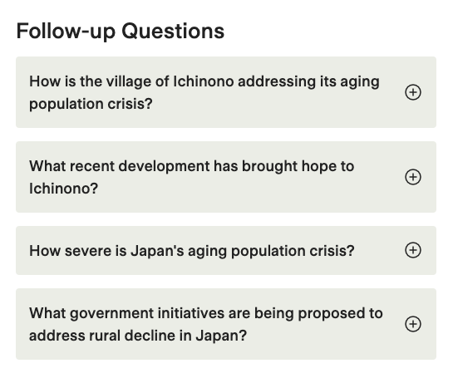
GAIA Digest
Notes:
We’re able to highlight the ‘common ground’ between different perspectives and sources covering a news event. This helps bring people together and understand what they agree upon, before diving into the nuances of the different viewpoints around a story.
We can also anticipate what questions may naturally arise, and use a variety of tools to create a set of “Follow Up” questions.

Slide 25
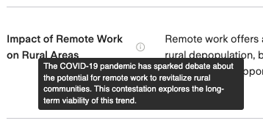
GAIA Digest - Perspectives
Notes:
Perhaps the most interesting, in my opinion, is our work in surfacing the different perspectives and narratives within a story’s coverage. We can do the work of trying to present each case in the best possible light, with quotes and other information to back it up.
This can be incredibly useful both for the average news consumer, but also journalists - in their work to do research, and understand where the biases may exist, not only in the external coverage, but potentially their own.

Slide 26
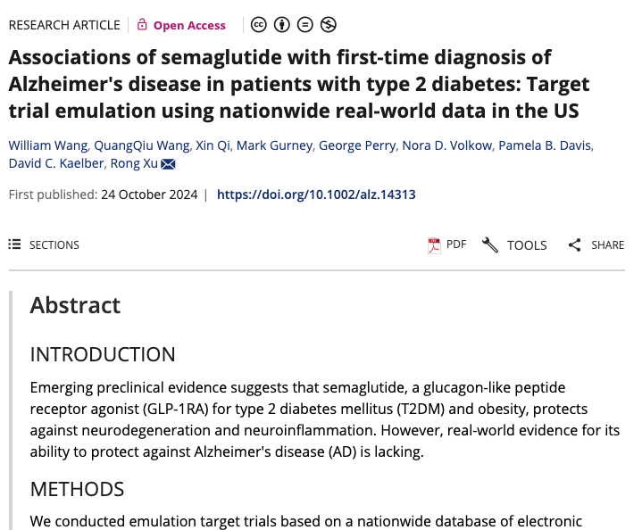
Primary Source Document Discovery
Notes:
Another powerful feature we have are working on with Generative AI is primary source document discovery. Many news stories often break around specific primary sources. Whether that is a scientific study, or a tweet, or a press release, we are able to surface the original content in many cases and present links to those to users, alongside descriptions of the primary sources and their significance within the story.

Slide 27
Lessons Learned with GenAI
LLM Hallucinations are a real problem
Multi-agent debate
Citations
Human-review
LLMs have, within them, an ingrained bias.
One of the interesting things about LLMs is that they inherit the bias present in their training data. As such, you cannot simply “tell” the LLM to assign a bias rating on a piece of text and trust the output reliably.
The creators also place their own ‘moderation’ guardrails, which sometimes give funny results.
Notes:
Here are some lessons we’ve learned along the way when working with generative AI. Hopefully some of this may be useful to you in your use-cases of these generative models.
LLM hallucinations are a real problem. Hallucinations is the term we use to describe when a large language model decides to ‘make up’ its own answer. They do not ‘go away’ with 100% certainty, even if all the content needed is within the prompt provided. Additional guardrails are necessary. In our work, we find that far too many organizations are using LLMs, particularly independent news aggregators, in ways that clearly do not have guardrails in place. This is very dangerous.
These can be mitigated in several ways. Some include incorporating multi-agent debate, where you have several models try to ‘fact-check’ a piece of text against a corpus and they have to agree on the same pass or fail score, else they go back and forth until they can or cannot come to a conclusion. You can also make sure to include citations in your generated work, and as a final step - adding that ‘human-review’ element really helps ensure truthful information. A lot of my work at Ground news specifically goes into developing our own guardrail systems to mitigate these hallucinations as much as possible.
An early project I worked on with LLMs was getting it to generate an analysis across three different pieces of text - left / center / right. The focus was to identify the difference in language, tone, and content. However, sometimes due to the nature of the coverage, there would be one side missing (like in a blindspot), where there is mostly only left leaning and center leaning coverage. When asked to identify the differences, the model would often hallucinate and make up a ‘stance’ for the missing bias-side, in this case the “right-leaning” perspective. We realized that part of the problem, was that we were telling the model that we were giving it a left leaning and a center leaning piece of text! In its effort to be neutral, it felt that it needed to provide a balanced perspective by showing “all” perspectives, even if some of them were missing.

Slide 28
How do you feel about the emergence of AI in Journalism
Excited
Optimistic
Neutral
Pessimistic
Terrified
Notes:
Let’s return to the question from earlier. How do you feel about the emergence of AI in Journalism. Do you see it as a risk or an opportunity?

Slide 29
Thank you
https://ground.news

