Slide 1
US presidential debate 2024 live blog analysis
Strong performance compared to an average China section article
Kamala Harris, Donald Trump clash over China, tariffs in US presidential debate – as it happened
388% more users than the average SCMP article
548% more regular+loyal users than the average SCMP article
On average, readers stayed on the page for 3.5 minutes (very high)

Slide 2
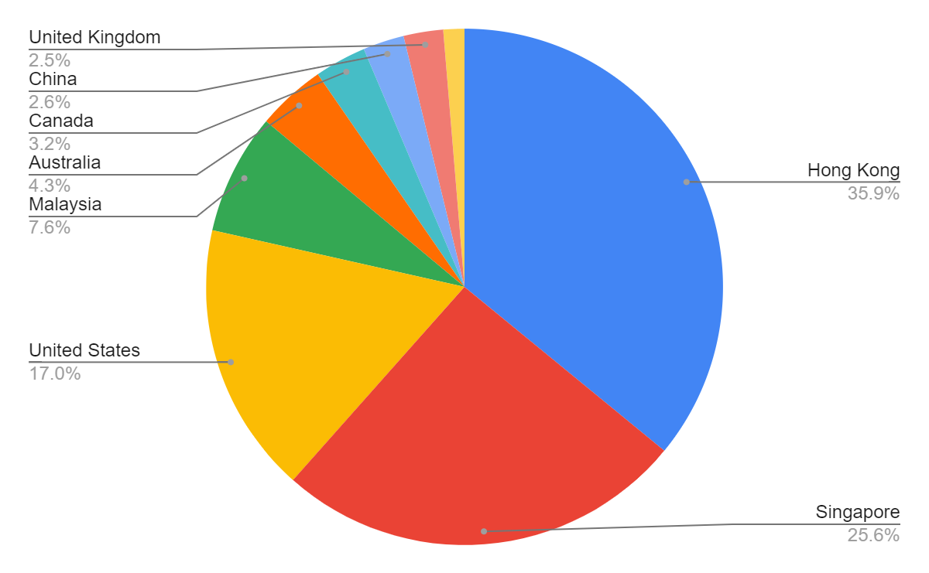
US presidential debate 2024 live blog analysis
Most of the audience came from Hong Kong and Singapore but plenty of US readers too

Slide 3
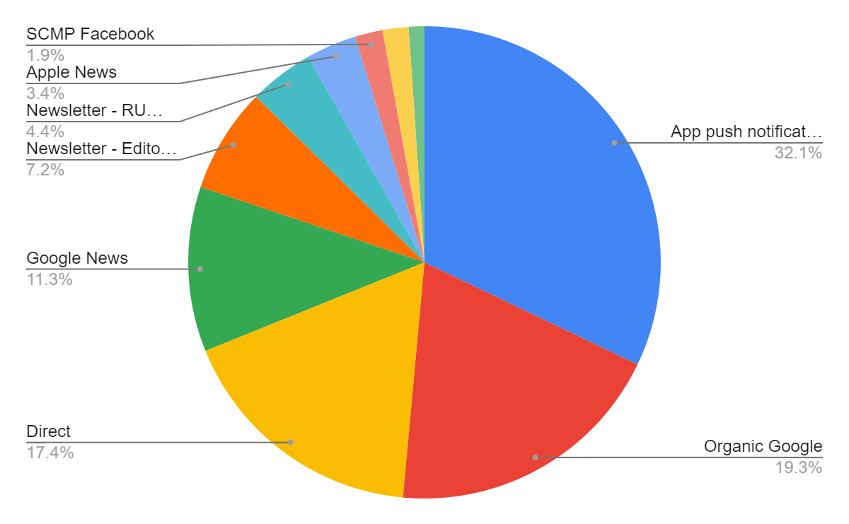
US presidential debate 2024 live blog analysis
Most readers came from app alerts, but surprising amount from Google Search and News given competition

