Slide 1
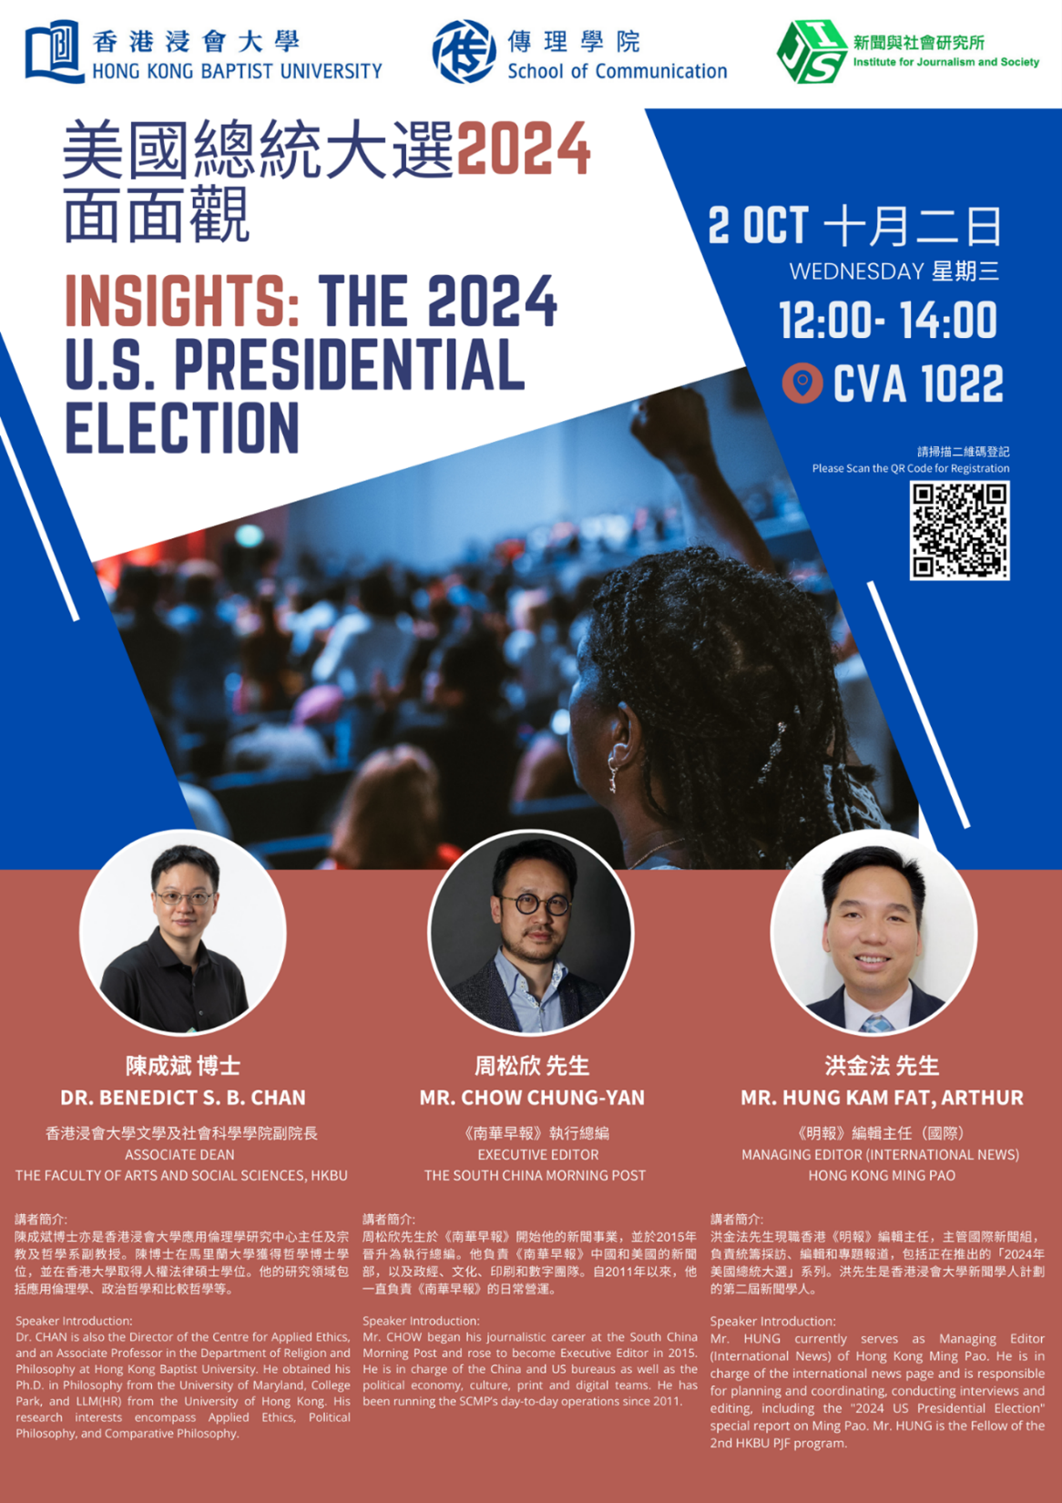

Slide 2
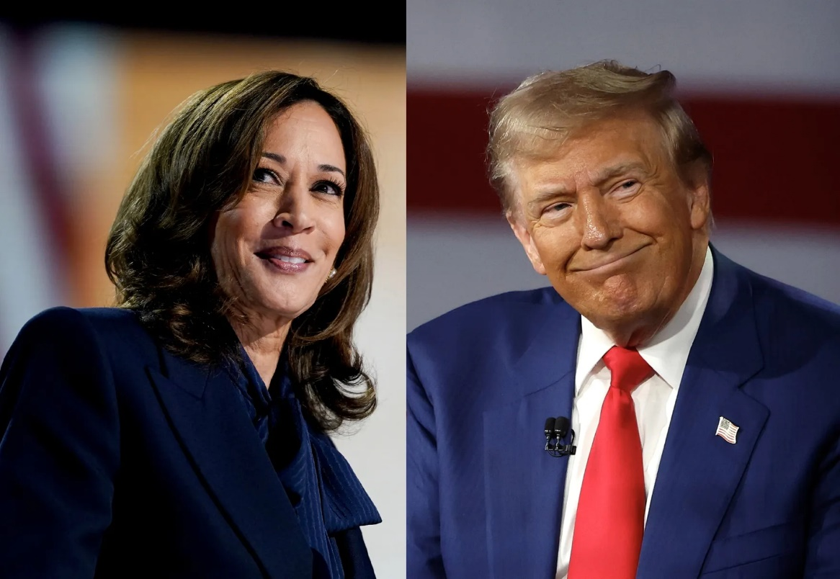
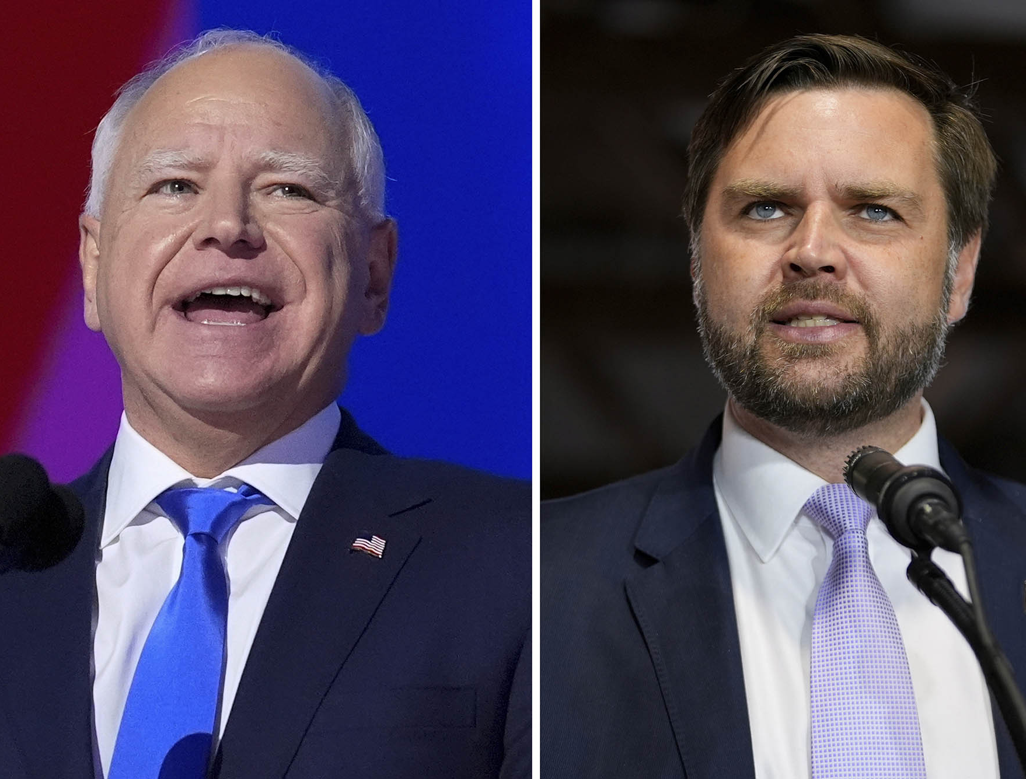

Presidential Election 2024

Slide 3
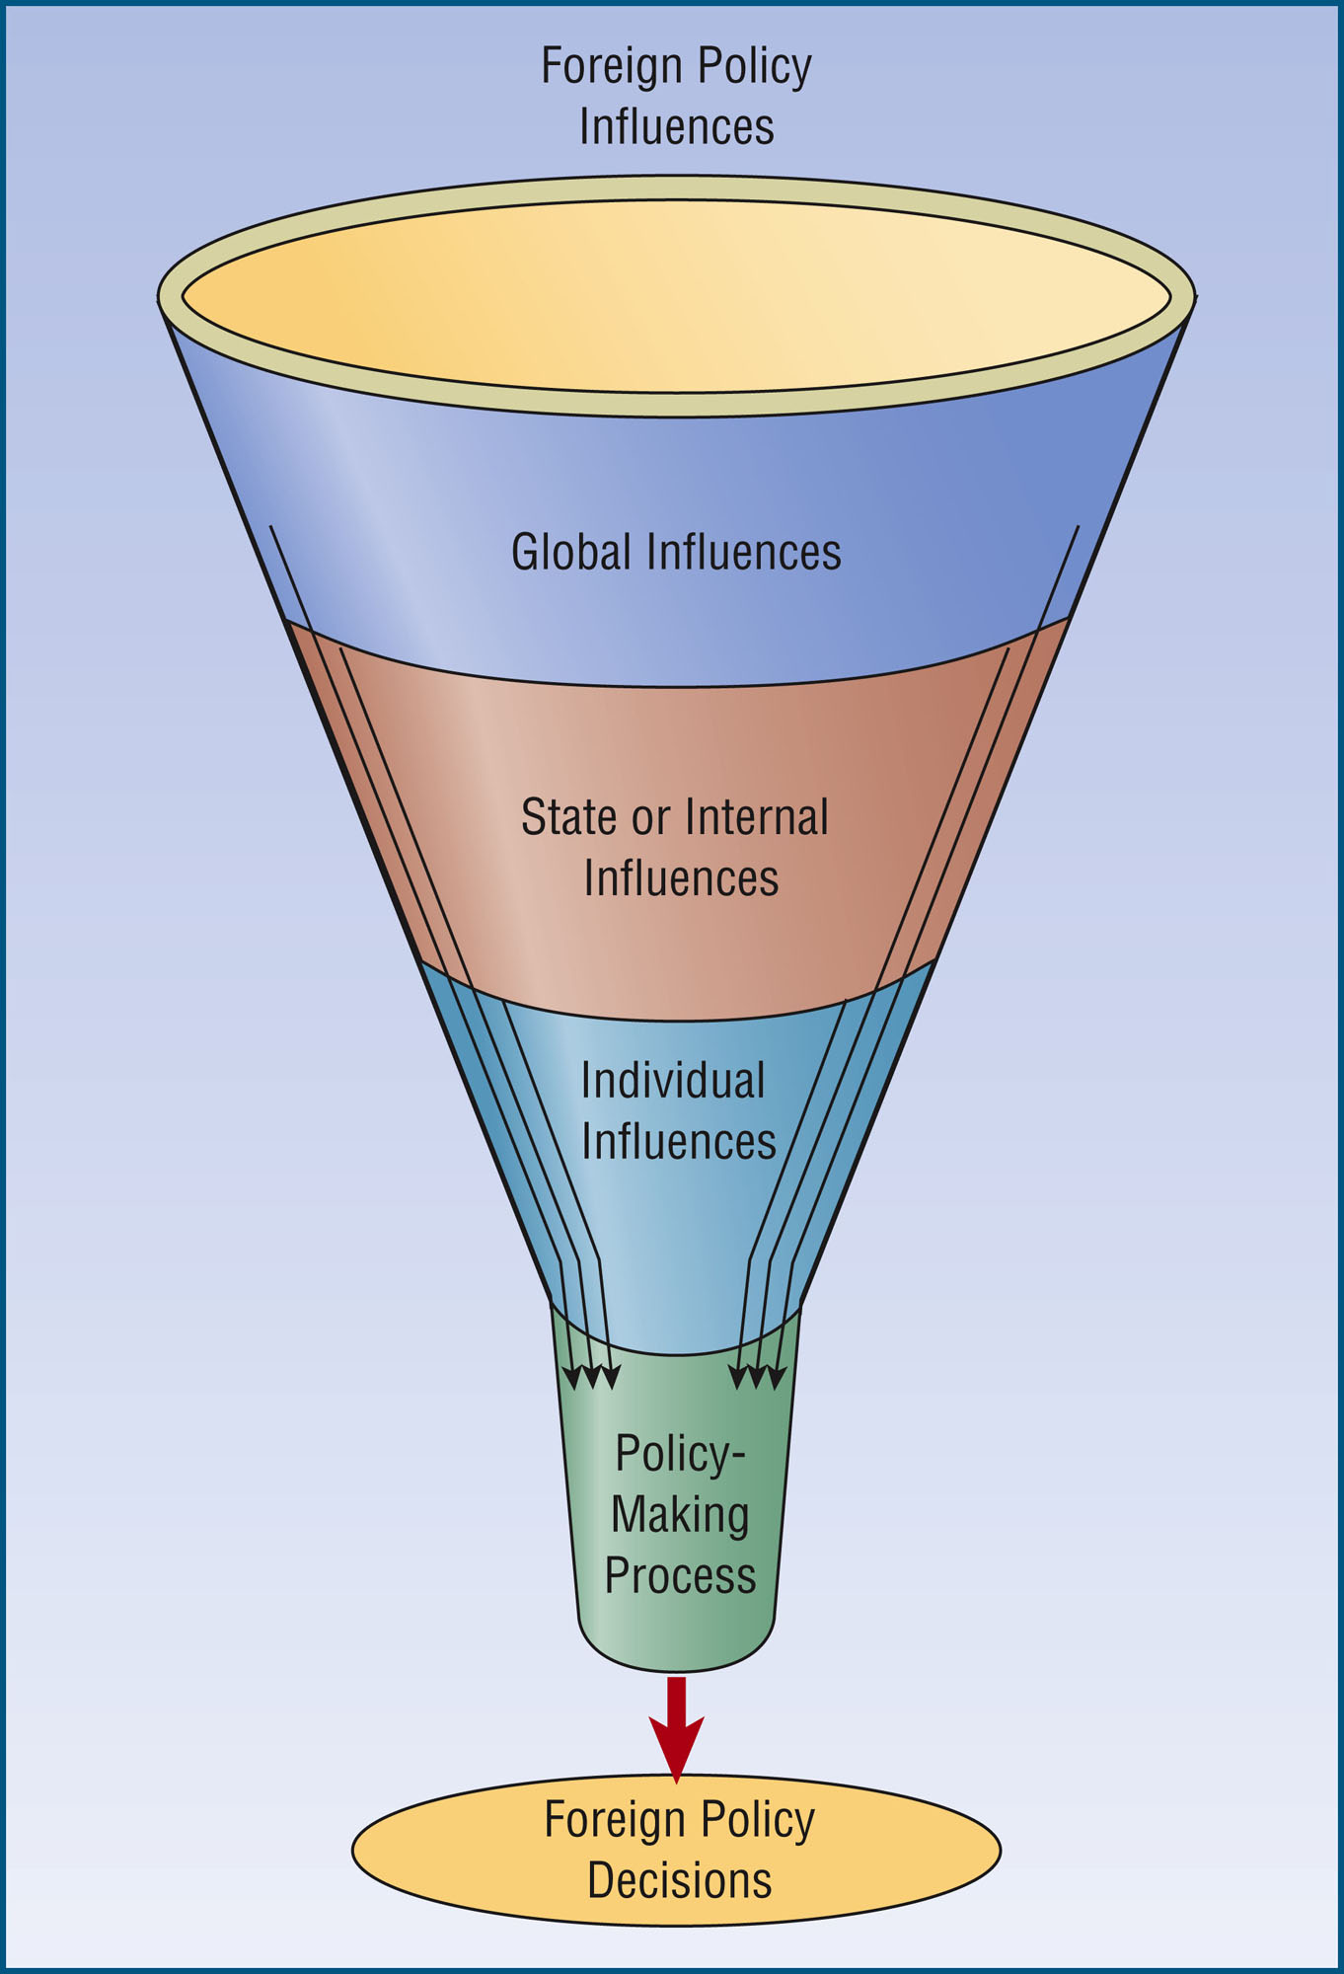

Slide 4
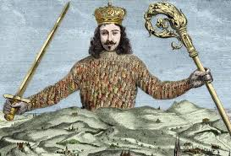
The Realist Perspective on World Politics
The oldest theory of international relations; also one of the three main approaches in international relations (the other two are liberalism and constructivism)
  Many versions of realism; we just need the most basic
Hobbes – state of nature (Compare with Xunzi in Confucianism or Han Fei Tzu and Shang Yang in Legalism in the Warring State Period in China)

Slide 5
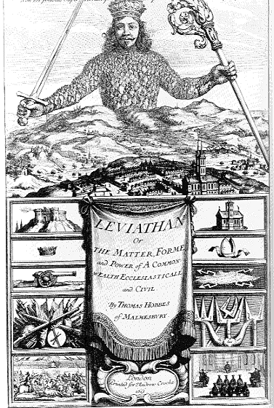
Quote- State of Nature
“To this war of every man against every man, this also is consequent; that nothing can be Unjust. The notions of Right and Wrong, Justice and Injustice have there no place. Where there is no common Power, there is no Law: where no Law, no Injustice” (Book 1 Chapter XIII of Leviathan)

Slide 6
State of Nature (International Version)
Unit: State (instead of individual person)
War of Everyone against Everyone
No World-Government
“No” Right and Wrong in international level, just like no right or wrong in state of nature.
  Only established after having contracts and the government (different from others, such as Locke, Rousseau, or Rawls)
  Hobbesian vs. International?

Slide 7
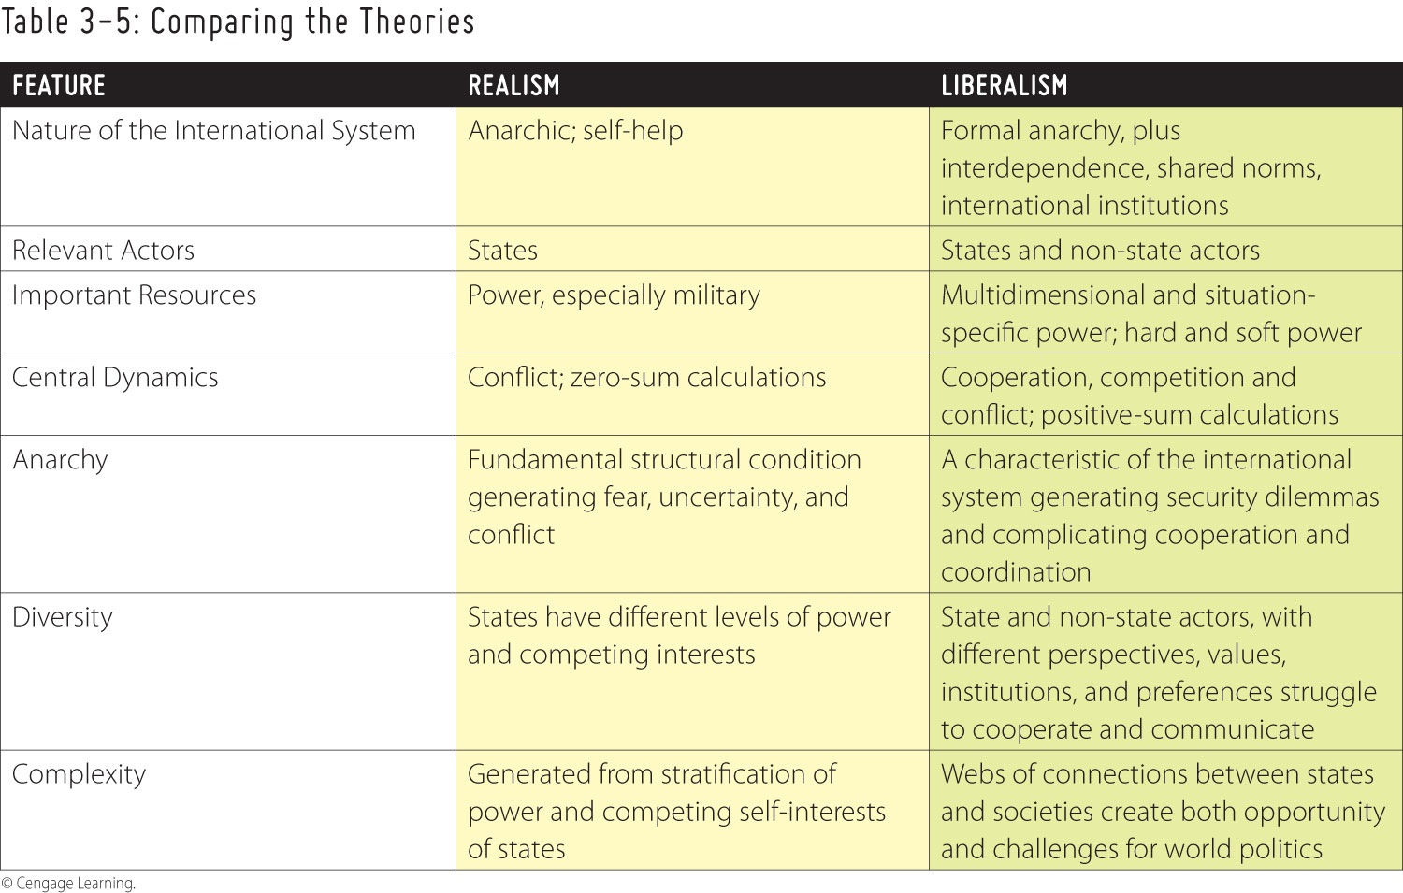
Summary of Realism and World Politics
Notes:
Table 3-5: Comparing the Theories
© Cengage Learning

Slide 8
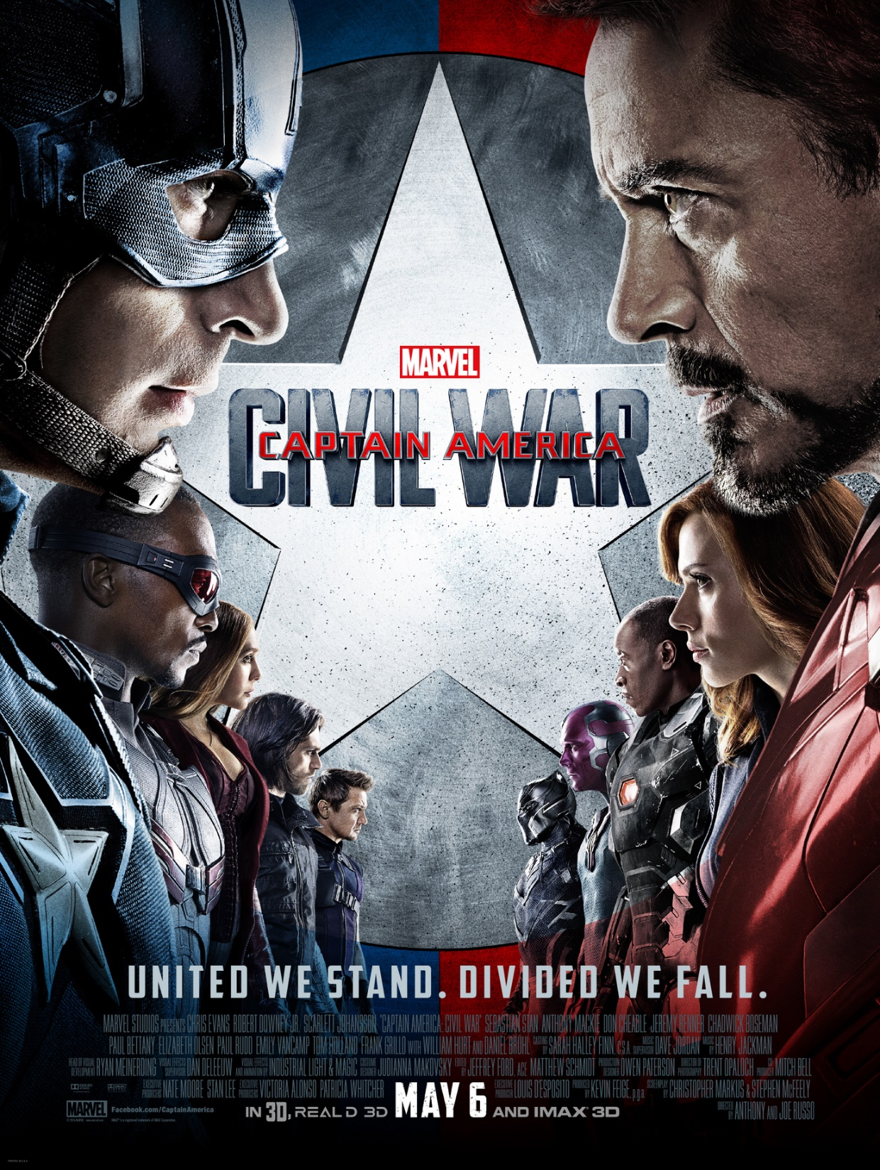
Sokovia Accords Debate in Captain America 3: Civil War
The Political Philosophy of Captain America: Civil War
  Realism vs. Liberalism
  Deontology vs. Utilitarianism (?)
Movie Clip 1
Movie Clip 2

Slide 9

Common Political Positions
The two dominant positions:
Pro-life (or “Conservative”):
  Abortion is killing a human being,
  Therefore morally wrong & ought to be illegal
Pro-choice (or “Liberal”):
  Abortion is essentially a private act
  A medical procedure
  Therefore not morally wrong & ought to be legally permissible
They are not only relevant to law and liberty, but also morality (Another e.g., homosexual Marriage)

Slide 10
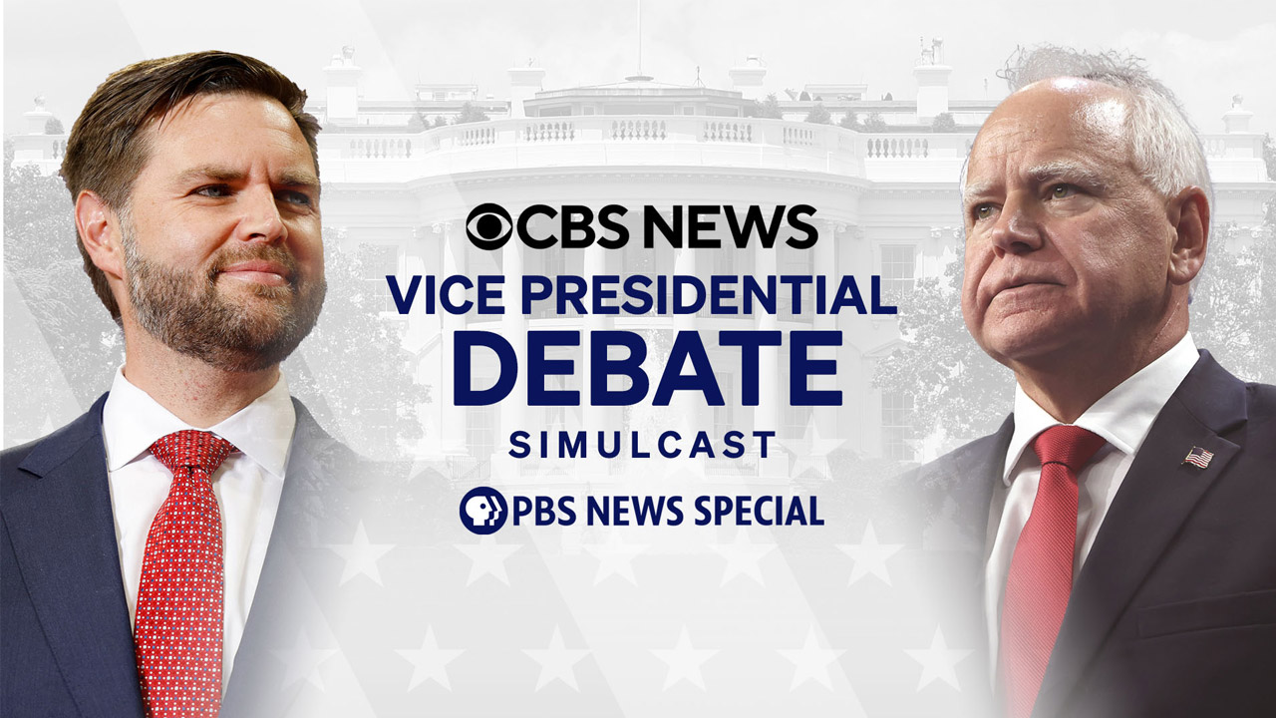
Issues
Economy (Justice)
Gun Control
Healthcare
Illegal Immigration
Homosexual Marriage *
Democracy/Election

Slide 11
Comparison of Votes in WI
Candidates | Population Vote | %
2012
Obama | 1,613,950 | 52.8
Romney | 1,408,746 | 46.1
2016
Clinton | 1,381,823 | 46.4
Trump | 1,404,000 | 47.2
2020
Biden | 1,630,866 | 49.45
Trump | 1,610,184 | 48.83

Slide 12
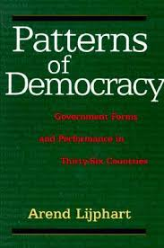
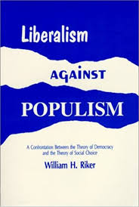
Modern Models
Examples: U.S.A. vs. U.K.; U.S.A. vs. H.K.!!
Patterns of Democracy (Westminster Model vs. Consensus Model)
In the liberal view, the function of voting is to control officials, and no more. (Riker, p.9) (vs. Populism pp. 11-12, and Ch.1)
Alternatives?
  Plato, Aristotle
  Meritocracy?

Slide 13

Comments/Q&A

