Slide 1
Facts MATTER
© Timothy A. Clary / AFP
Notes:
PHOTO (000_34439L8): SpaceX's Starship rocket launches from Starbase during its second test flight in Boca Chica, Texas, on November 18, 2023. SpaceX on November 18, 2023, carried out the second test launch of Starship, the largest rocket ever built that Elon Musk hopes will one day colonize Mars, while NASA awaits a modified version to land humans on the Moon. It comes after a first attempt to fly the spaceship in its fully-stacked configuration back in April ended in a spectacular explosion over the Gulf of Mexico. (Photo by TIMOTHY A. CLARY / AFP)

Slide 3
GLOBAL NEWS COVERAGE
IN 6 LANGUAGES
© Nicolas Asfouri / AFP
2,300
STORIES / DAY
3,000
PHOTOS / DAY
300
VIDEOS / DAY
1,500
LIVE STREAMS / MONTH
80
INFOGRAPHICS / DAY
100
VIDEOGRAPHICS / MONTH
Notes:
PHOTO (000_MM0A4): A television journalist stands on a ladder as he reports ahead of the CPPCC Closing ceremony at the Great Hall of the People in Beijing on March 13, 2017. (Photo by NICOLAS ASFOURI / AFP)

Slide 4
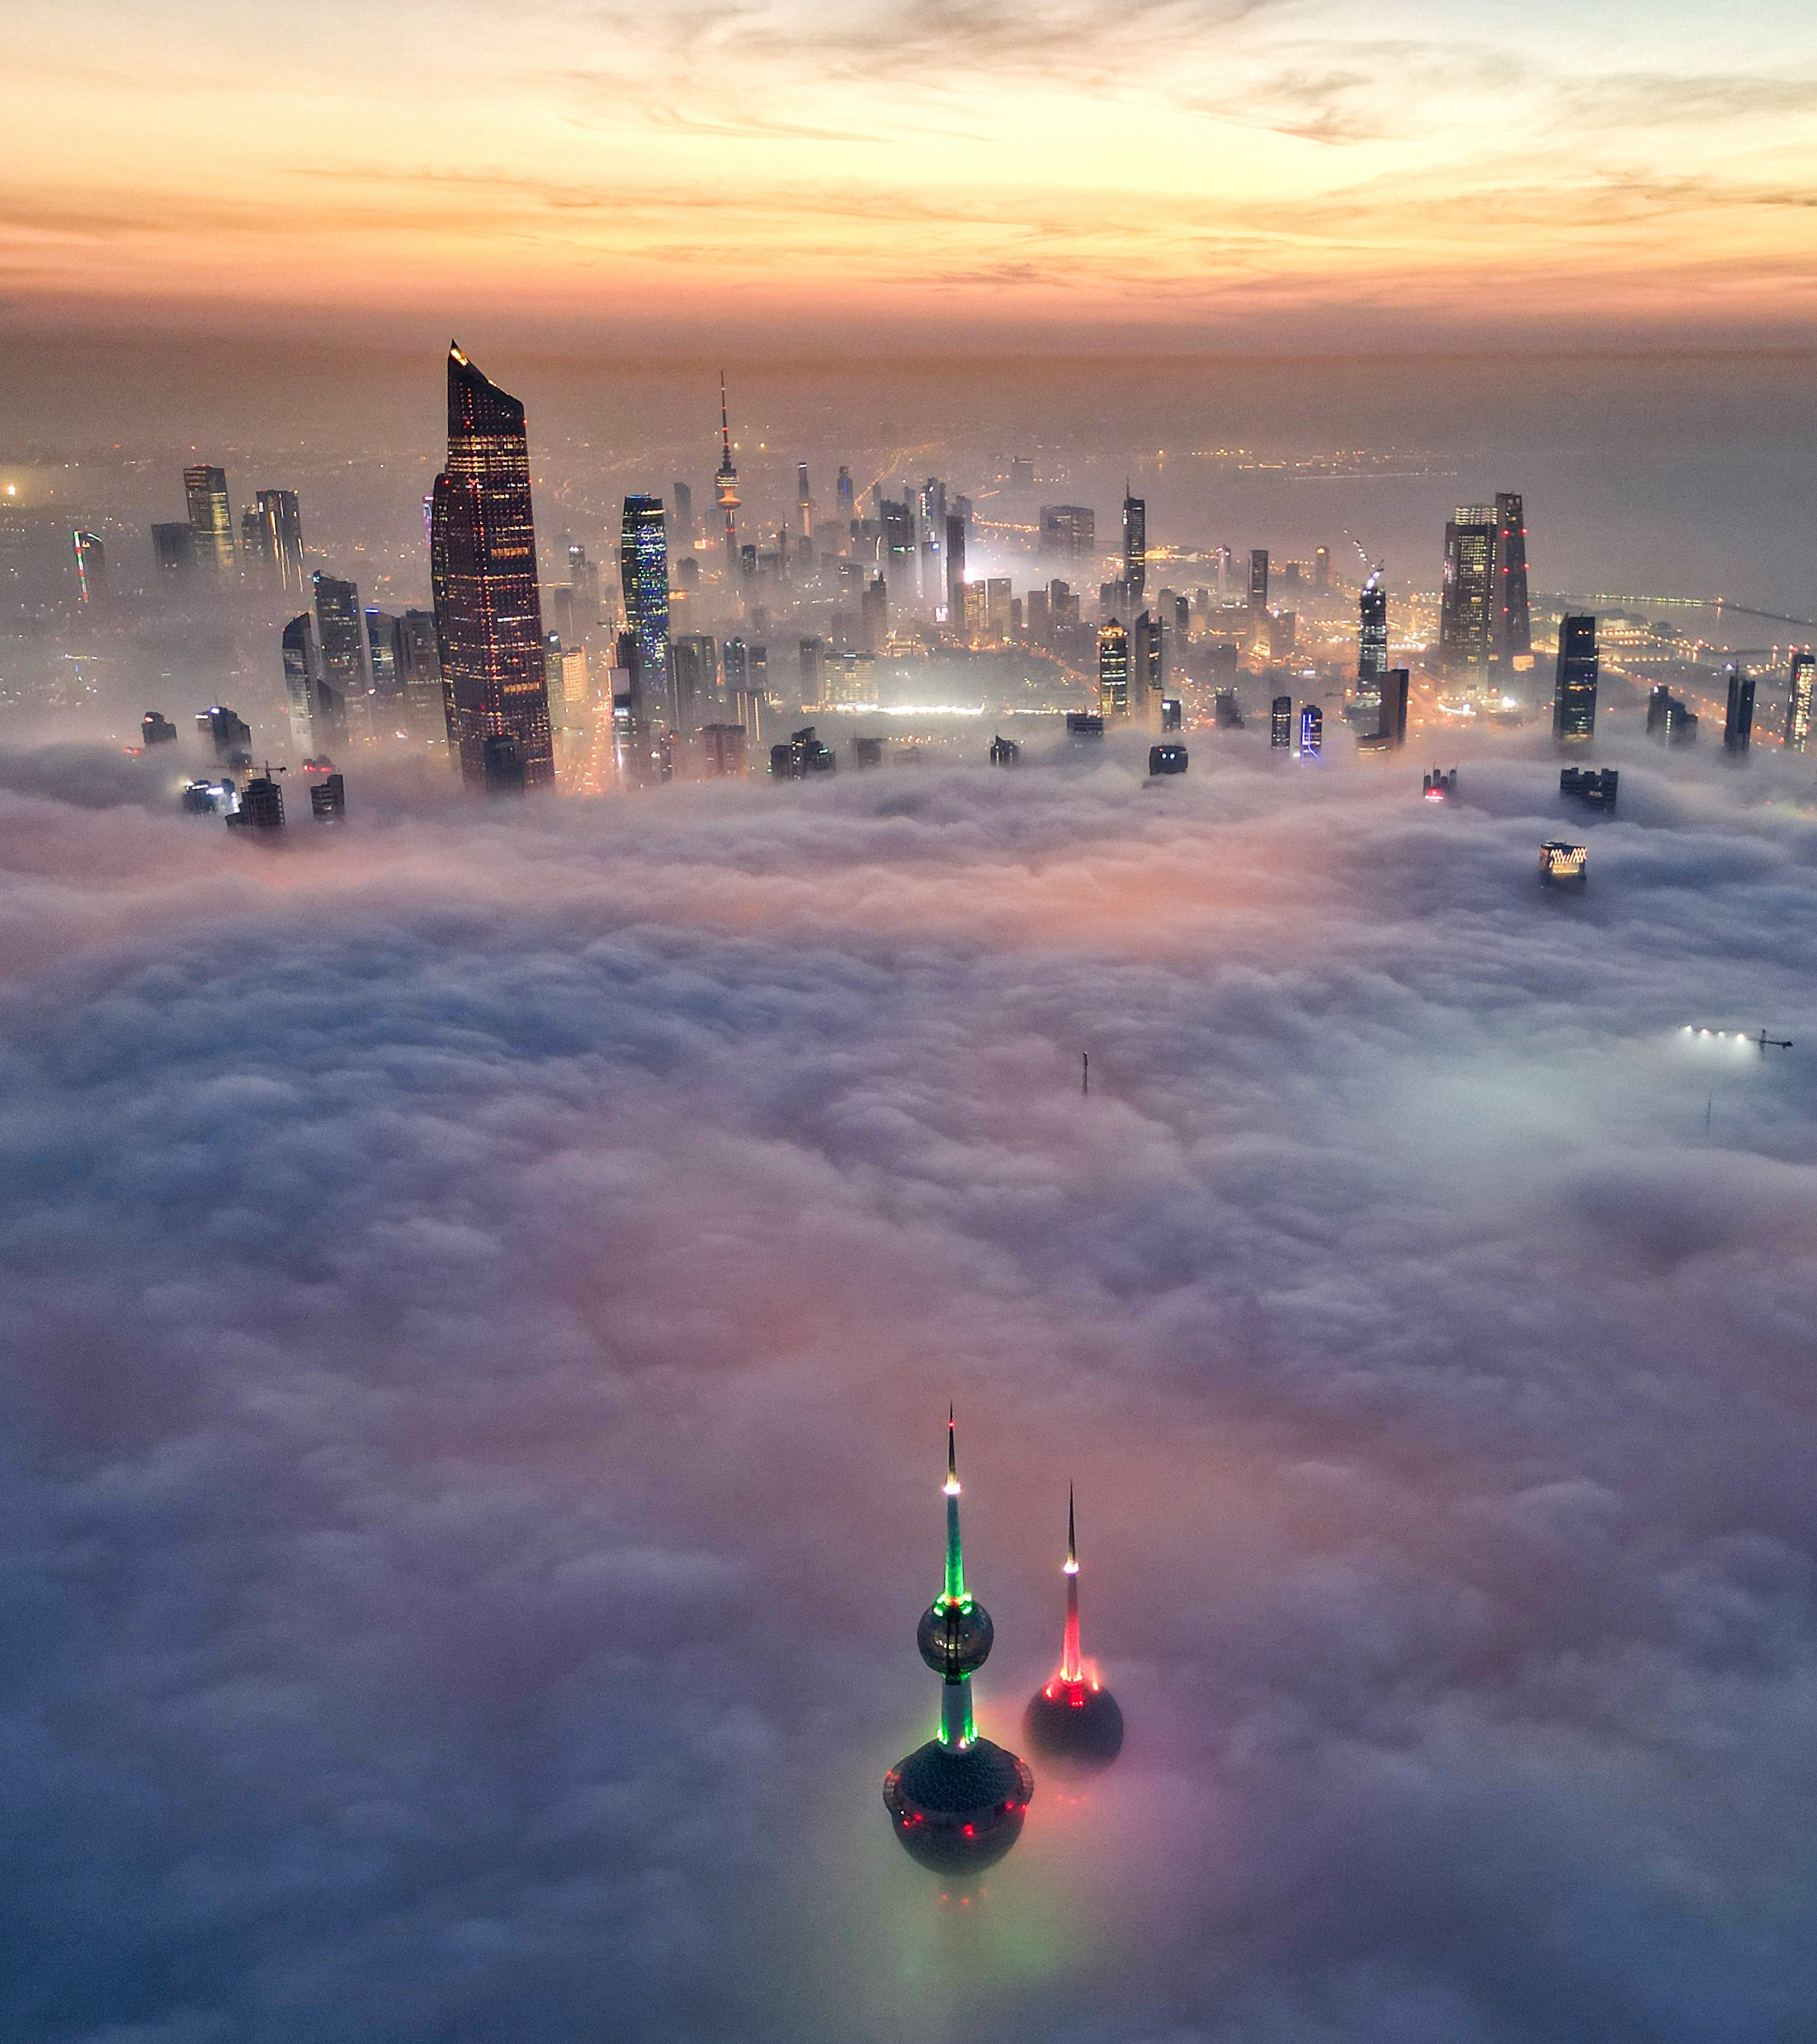
AFP’s Reach
© Yasser Al-zayyat / AFP
Regional headquarters in Paris, Washington, Montevideo, Hong Kong, and Nicosia.
4,000 clients worldwide, including more than 1,800 media clients covering every corner of the globe.
Notes:
PHOTO (000_347C994): In this aerial view, the landmark Kuwait Towers and other skyscrapers pierce through the cloud cover over Kuwait City on December 10, 2023. (Photo by Yasser Al-Zayyat / AFP)

Slide 5
Some basics
AI tools produce workflow efficiencies and can save journalists from performing tedious tasks.
They can speed up the production process.
But generative AI tools are prone to errors and bias, making automatic content creation problematic.
Newsrooms should maintain human oversight to ensure that these failings do not result in inaccurate content being published to their audiences.

Slide 6
The basic principle
AFP’s clients and audience must be confident that its production is the work of its journalists and not a third-party technology such as GenAI. Our role as a news agency is to provide accurate, verified news.

Slide 7
We updated our ethics code with an entry on AI

Slide 8
The first new entry since 2015

Slide 9
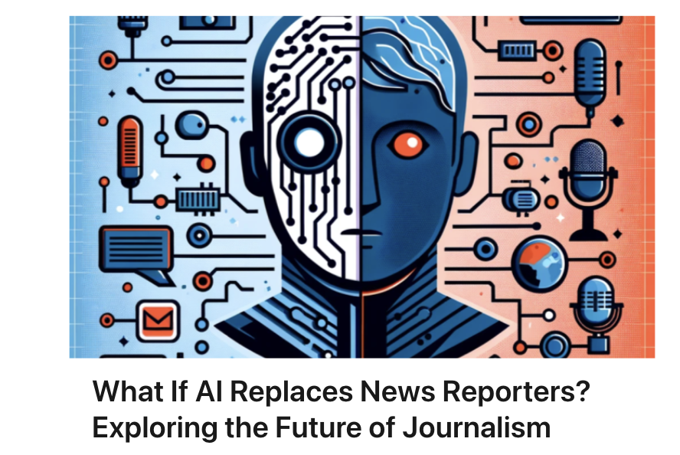

Slide 15
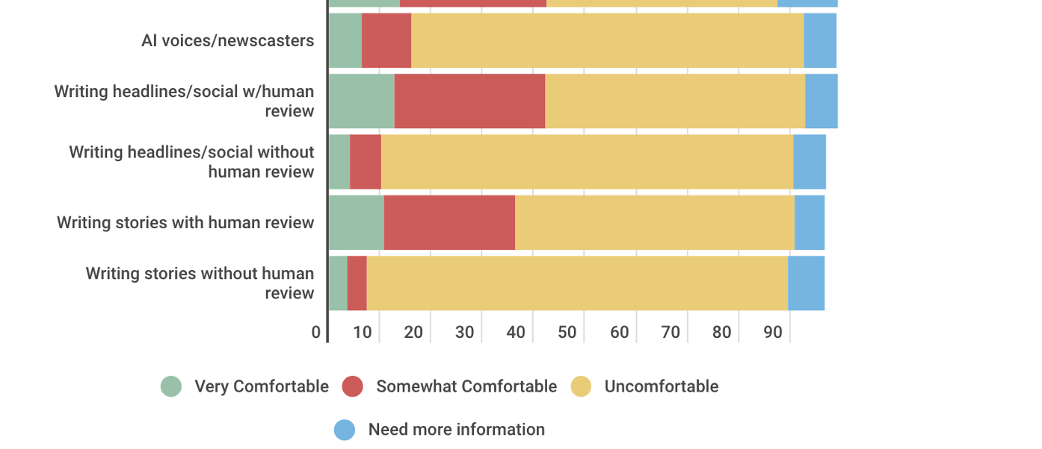

Slide 16
Allows AI in Story Preparation
Research
Summaries
Suggesting interview questions
Proposing story ideas
For translation
Voice – to – text transcription
Suggesting headlines
But all results must be checked, and nothing should be published directly online.

Slide 17
Speech to text
We must verify the quotes against our own recordings or notes before we use them in our production.

Slide 18
For translation

Slide 19
Photo
We do not publish or distribute images created wholly or partly using generative AI tools. This includes images created by our own teams and those supplied by our partners under redistribution contracts.

Slide 20
The Baltimore Times uses AI to create images of real people

Slide 25
The real tunnel workers

Slide 26
Adobe Stock criticised for selling AI images of the war in Gaza

Slide 27
As a result, it changed its policy and barred contributors from submitting AI images purporting to represent news events.

Slide 37
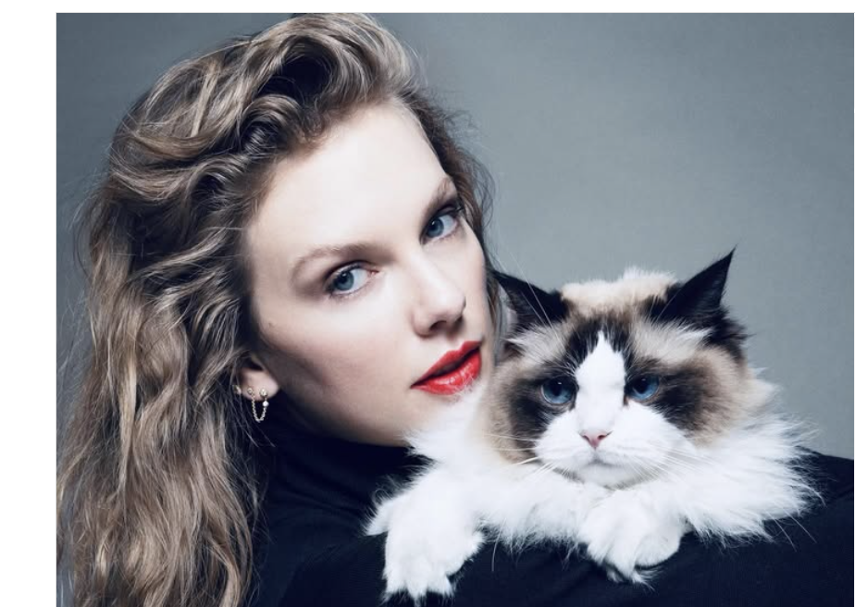
Taylor Swift endorses Kamala Harris
Recently I was made aware that AI of ‘me’ falsely endorsing Donald Trump’s presidential run was posted to his site. It really conjured up my fears around AI, and the dangers of spreading misinformation. It brought me to the conclusion that I need to be very transparent about my actual plans for this election as a voter. The simplest way to combat misinformation is with the truth.

Slide 38
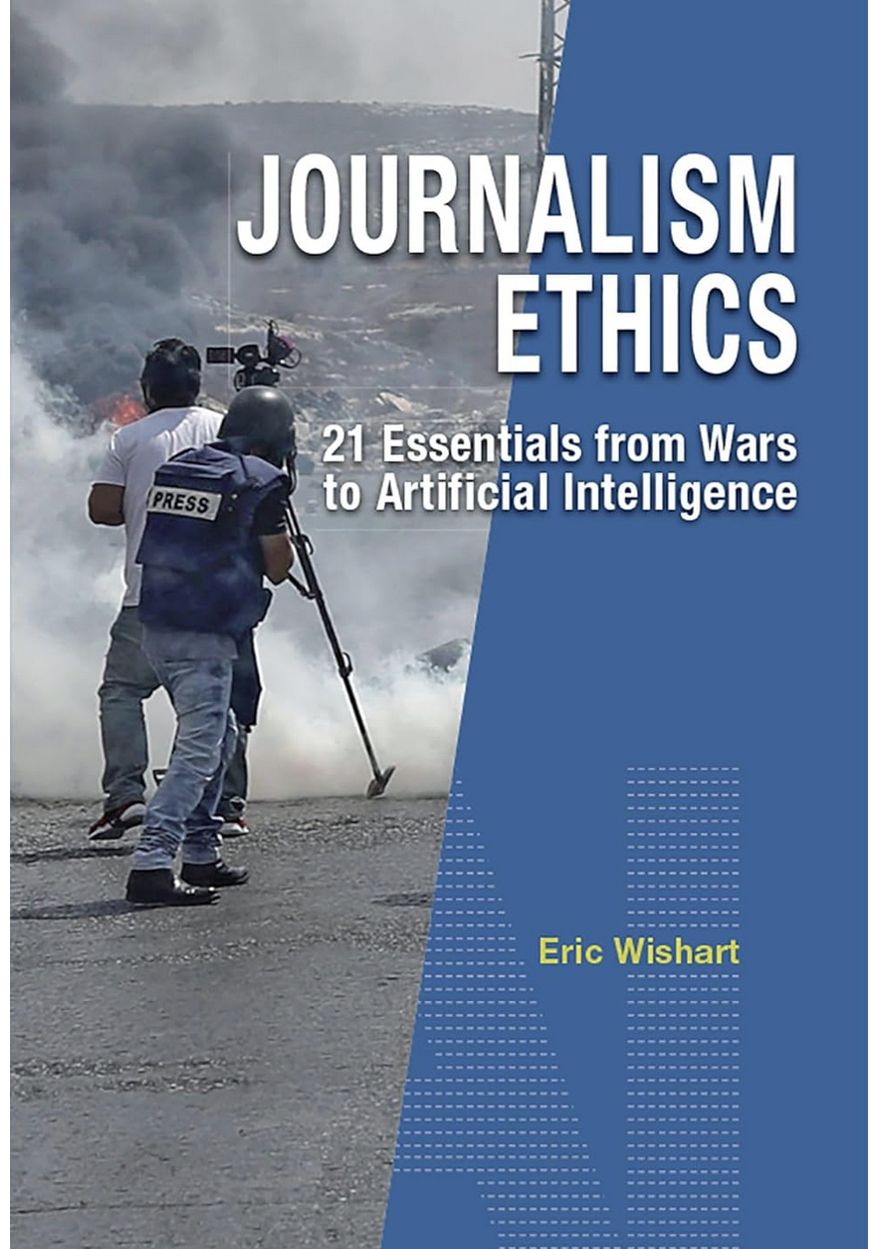
Thank You
ericwishart8@gmail.com
Eric Wishart on LinkedIn
@ericwishart on X

